Slide 1
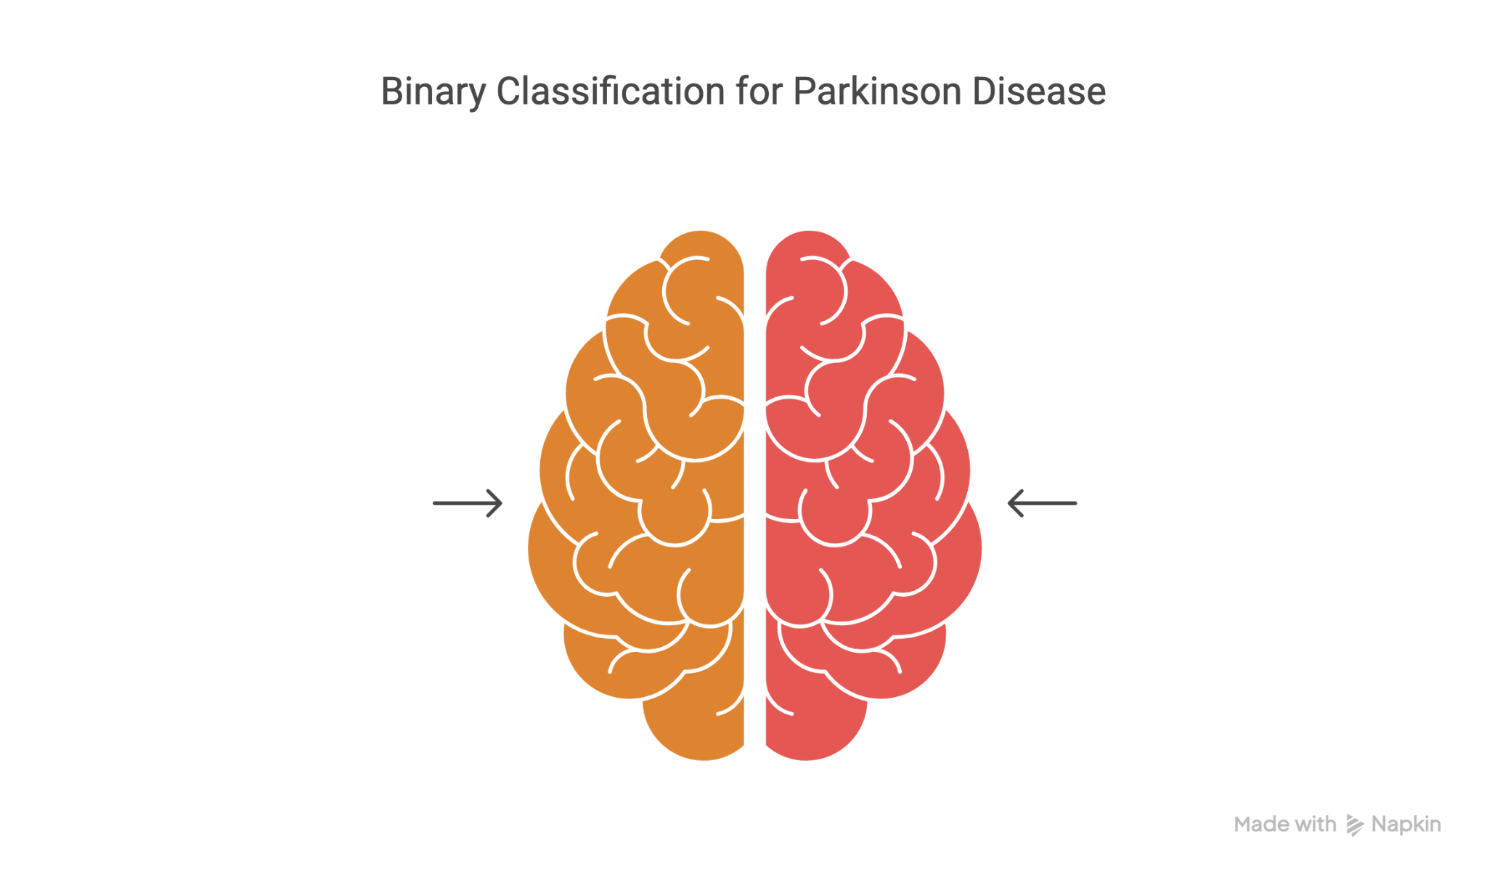
Parkinson Disease Classification using Multimodal Machine Learning
By: Manan Jain
06.05.2025

Slide 2
Introduction

Slide 3
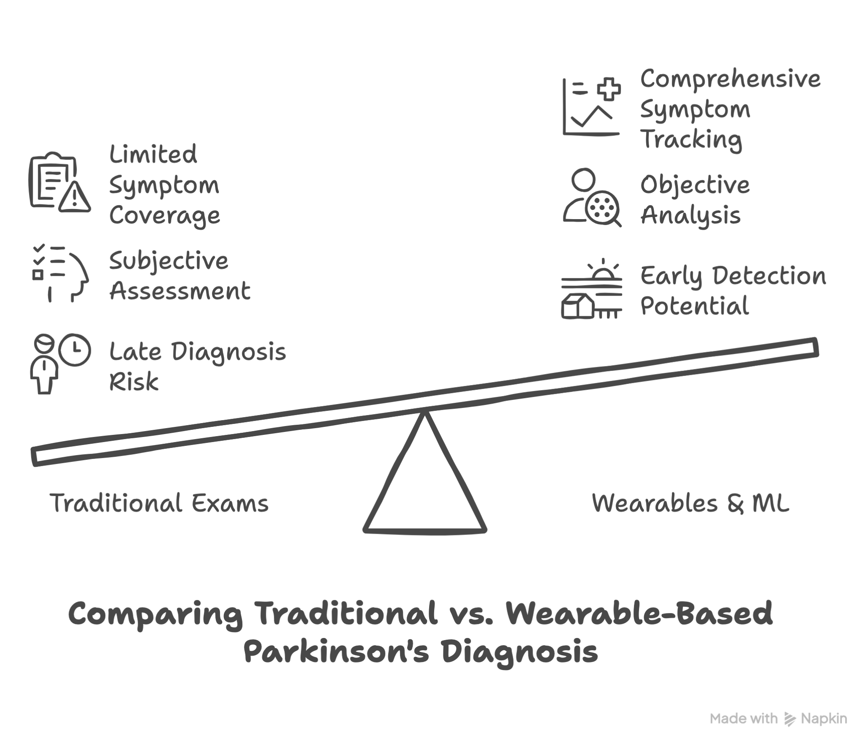
Notes:
“Parkinson’s Disease is typically diagnosed once motor symptoms like tremor or rigidity are noticeable, but by then, a majority of dopamine-producing neurons may already be lost — this makes early detection crucial for better outcomes.
The standard diagnostic methods, are subjective, depend on clinician interpretation, and often miss early signs — especially non-motor ones like sleep disturbance or smell loss.
Smartwatches and wearable IMUs offer a way to monitor motion in real life, capturing tremor, slowness, or coordination loss throughout the day.
When paired with machine learning, we can process these high-frequency signals and symptom questionnaires to identify PD earlier and more reliably, in a way that’s both interpretable and scalable.”

Slide 4
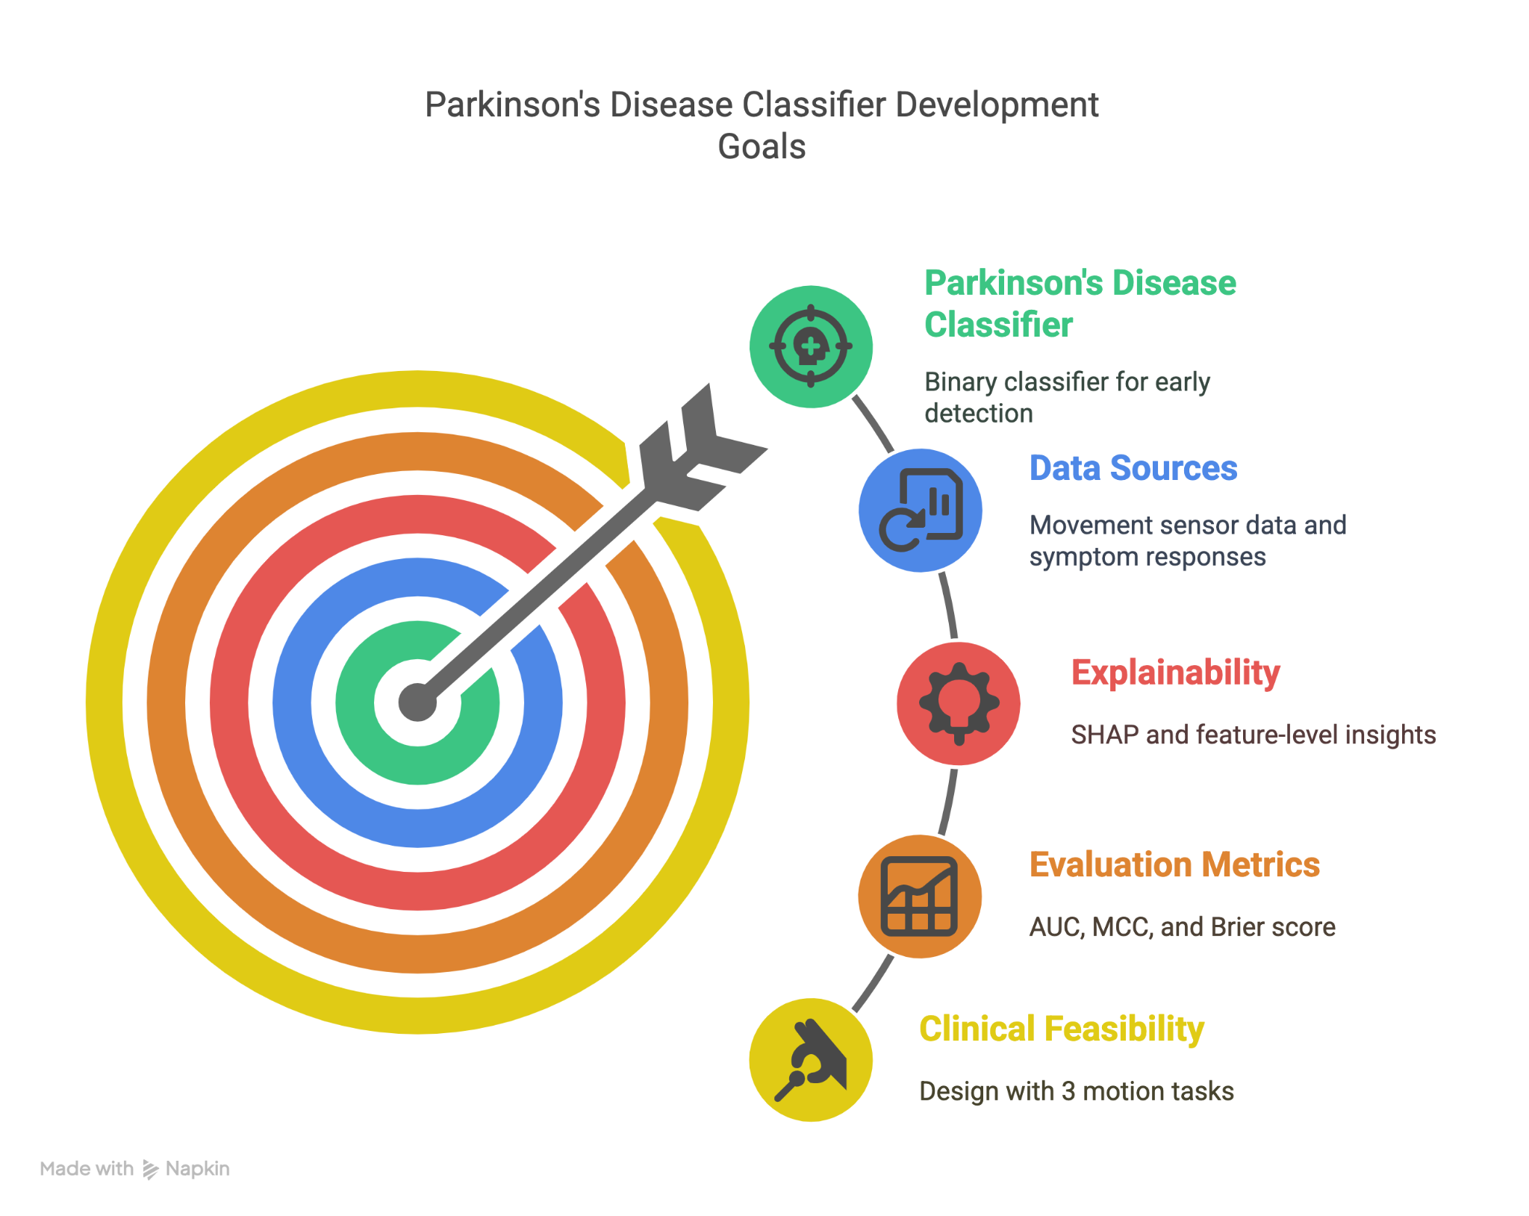
Notes:
“The goal of this project is to build a binary classification model that distinguishes people with Parkinson’s from those without — including healthy individuals and others with movement disorders.
What makes this unique is that we’re using both motion sensor data from smartwatches and non-motor symptoms from a structured questionnaire.
A core focus was interpretability — we wanted to ensure the model isn’t just accurate, but can explain which features are driving the prediction, using SHAP values.
We evaluated performance not just on accuracy or AUC, but also metrics like MCC(matthias correlation coefficient) to handle class imbalance and Brier score for probability calibration — important in clinical decision-making.
And importantly, we constrained the model to work with just three motor tasks, making it far more deployable in real-world or remote healthcare scenarios.”

Slide 5
Dataset

Slide 6
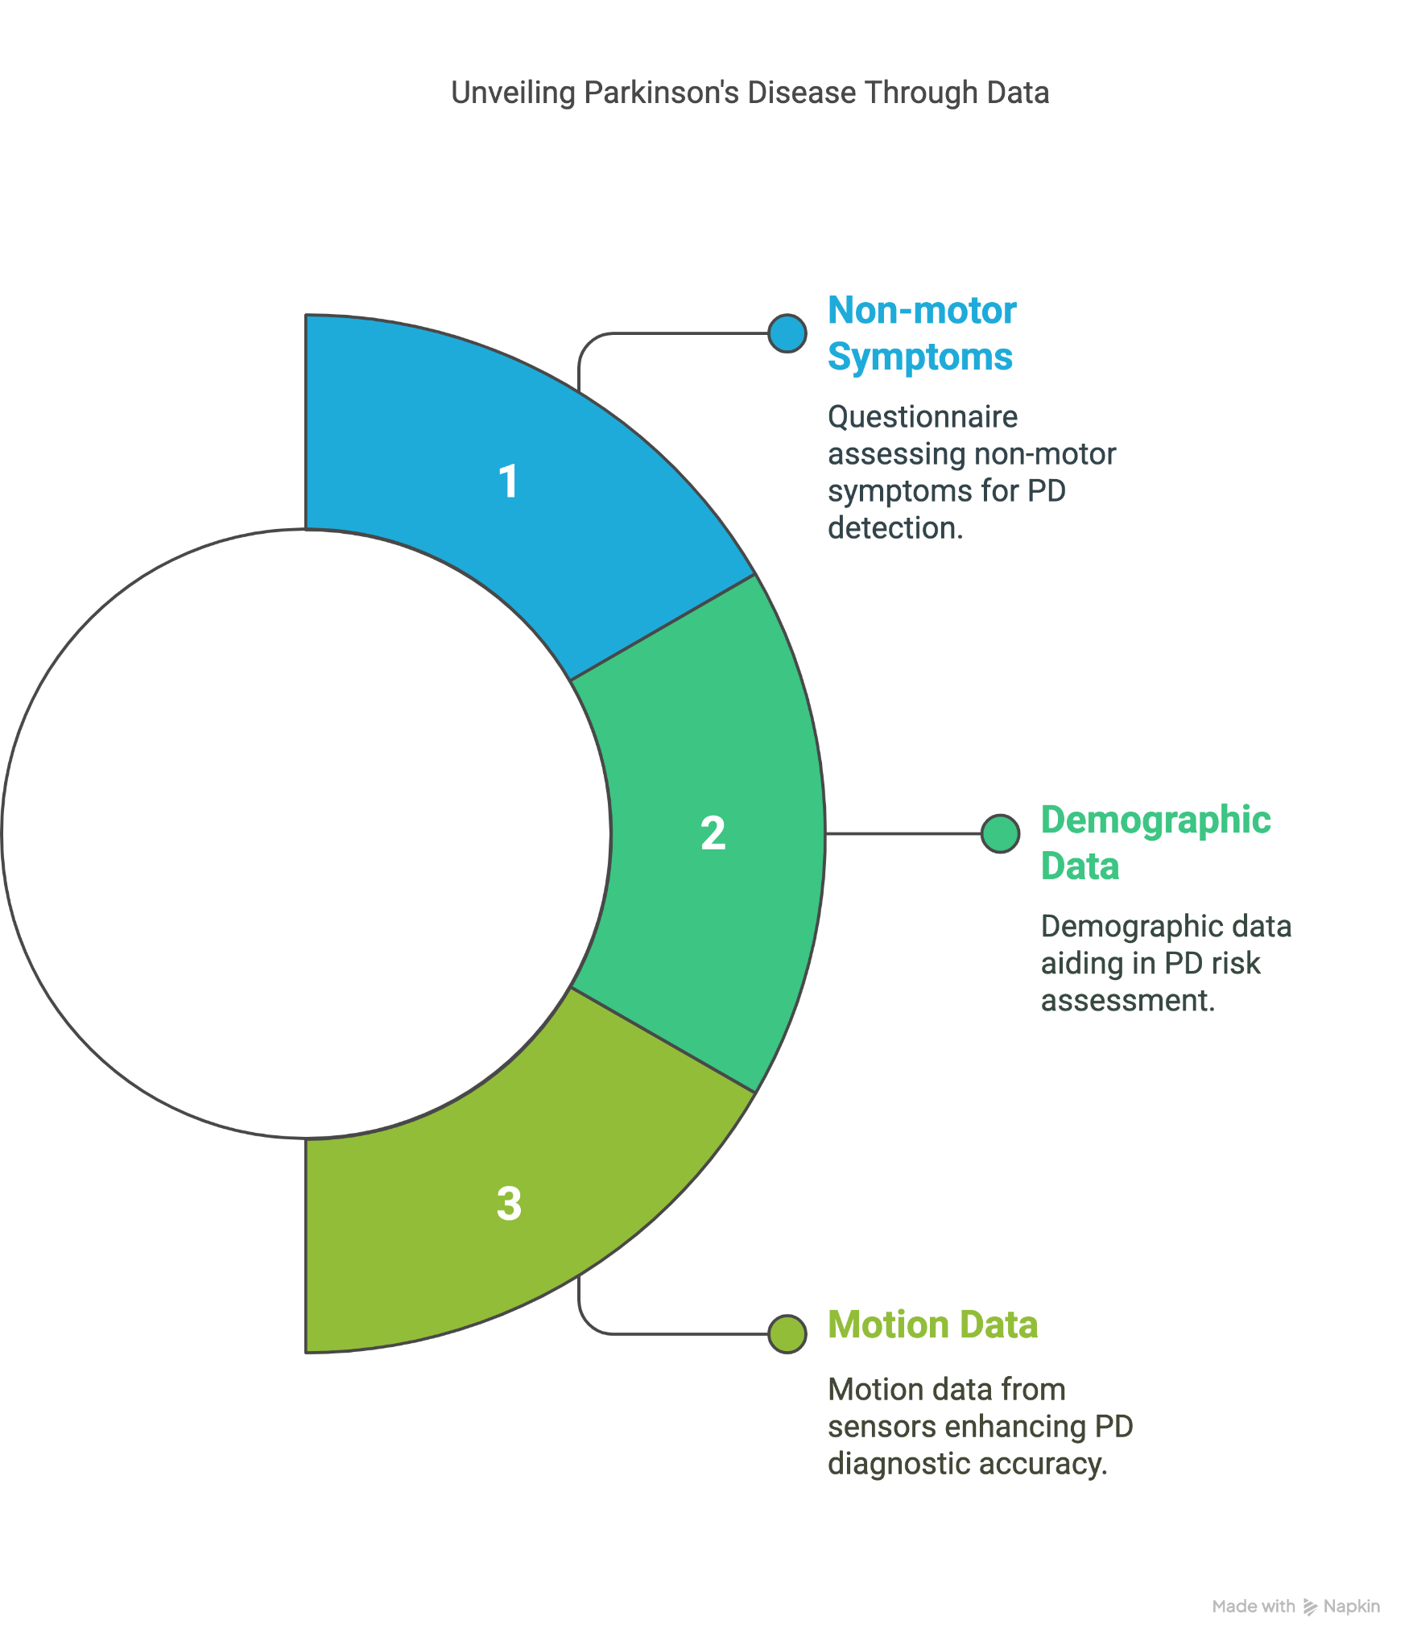
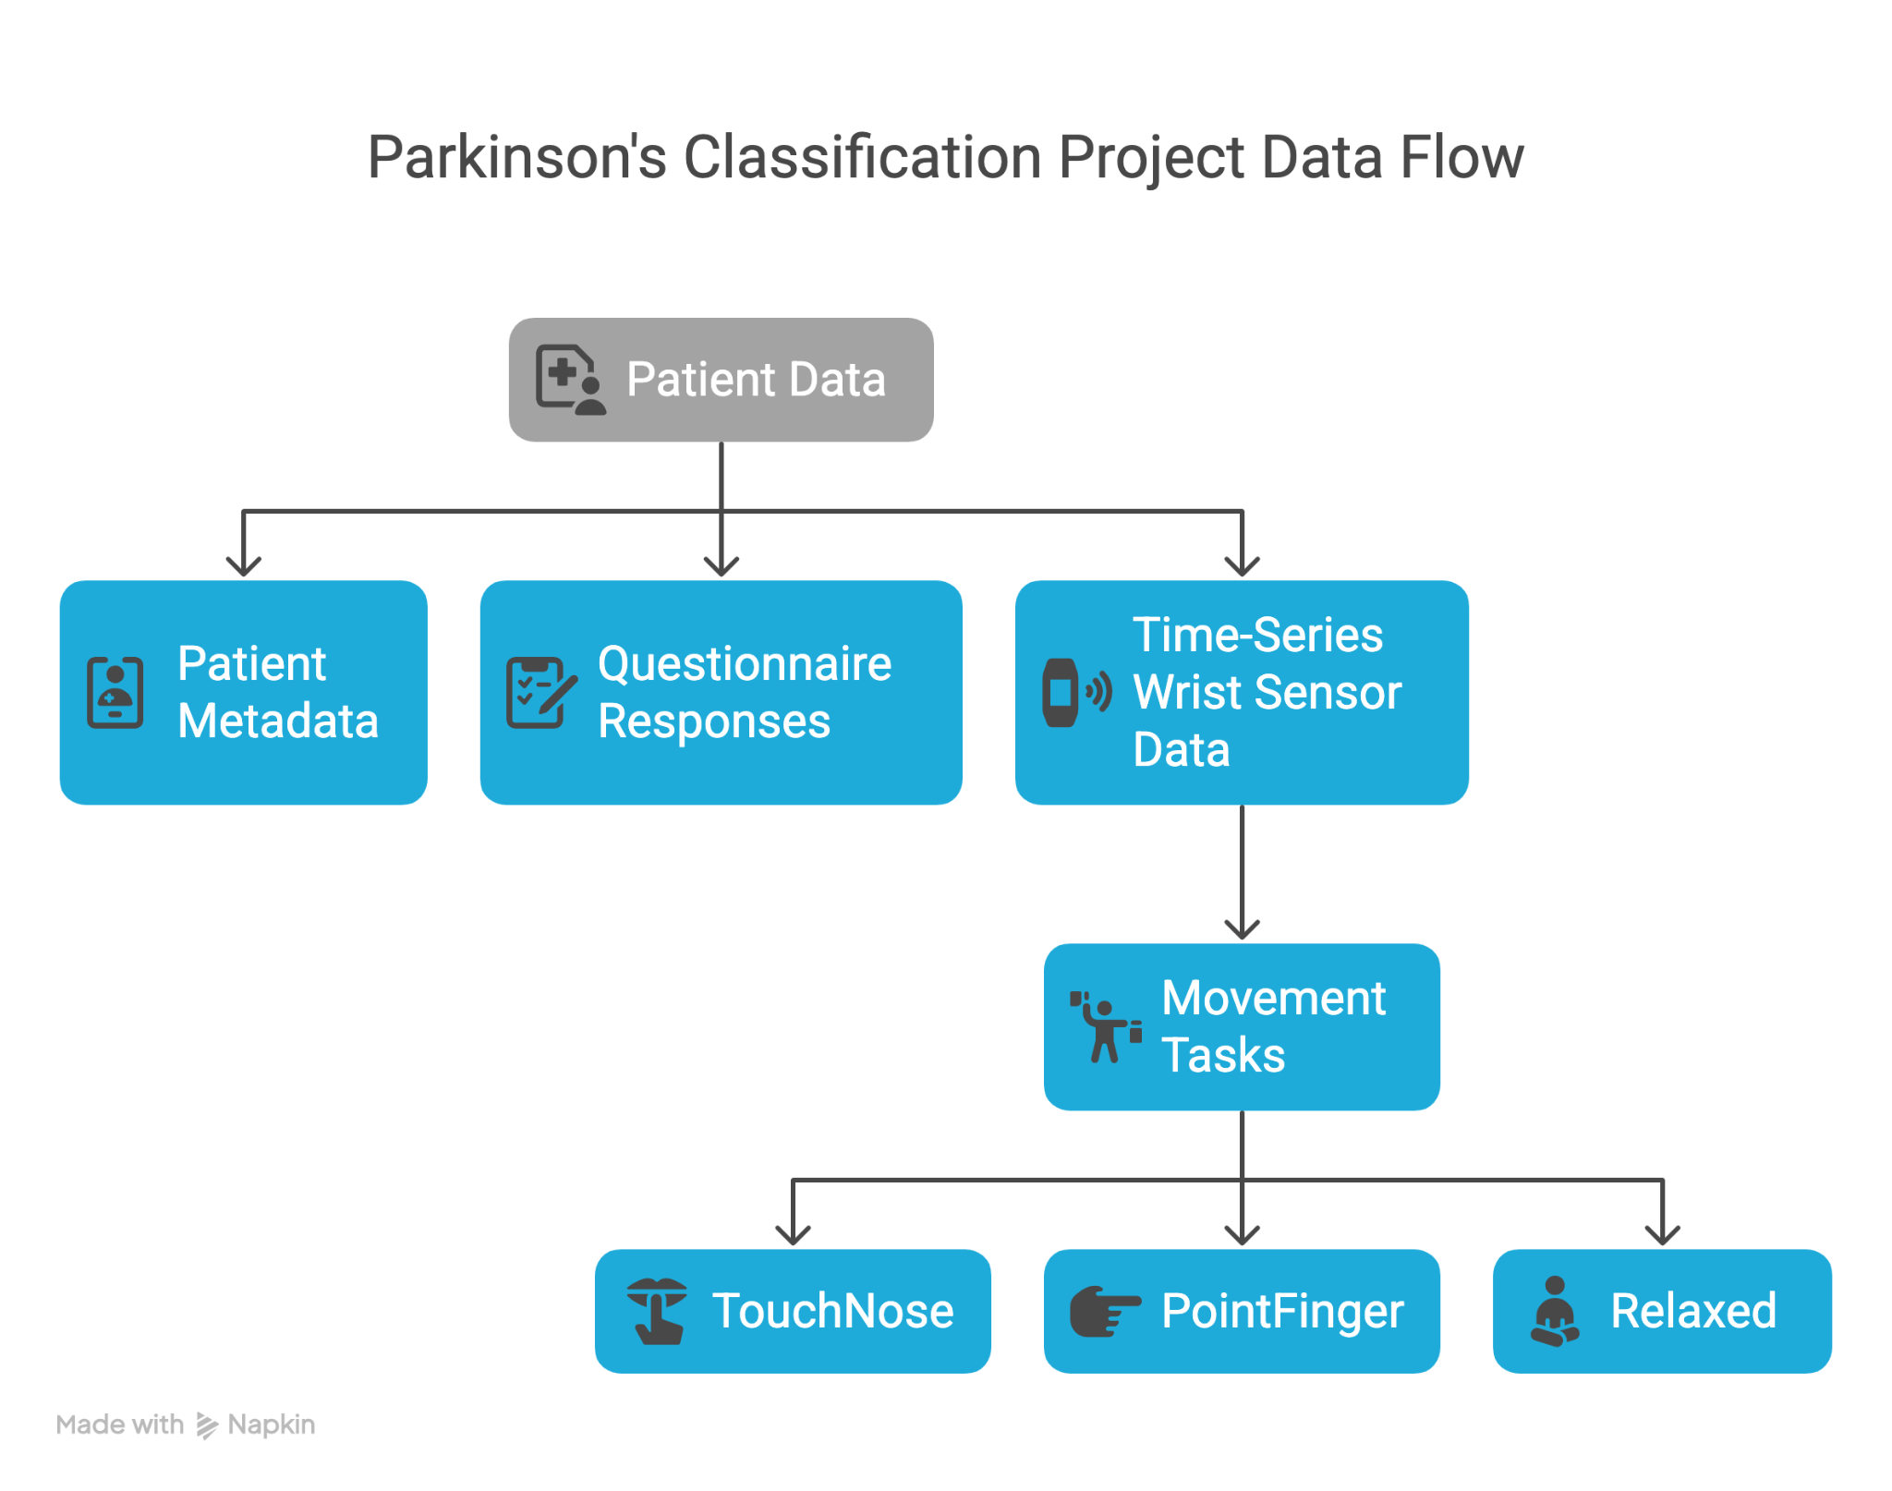
Reference : [1]
Notes:
We used the Parkinsons-disease-smartwatch - PADS dataset, a multimodal clinical dataset recently published via PhysioNet
The dataset includes synchronized motion signals from 11 tasks — such as TouchNose and Relaxed — recorded with wrist-mounted smartwatches.
Additionally, patients filled out a 30-question non-motor symptoms form. This allows us to study both motor and pre-motor indicators of Parkinson’s.

Slide 7
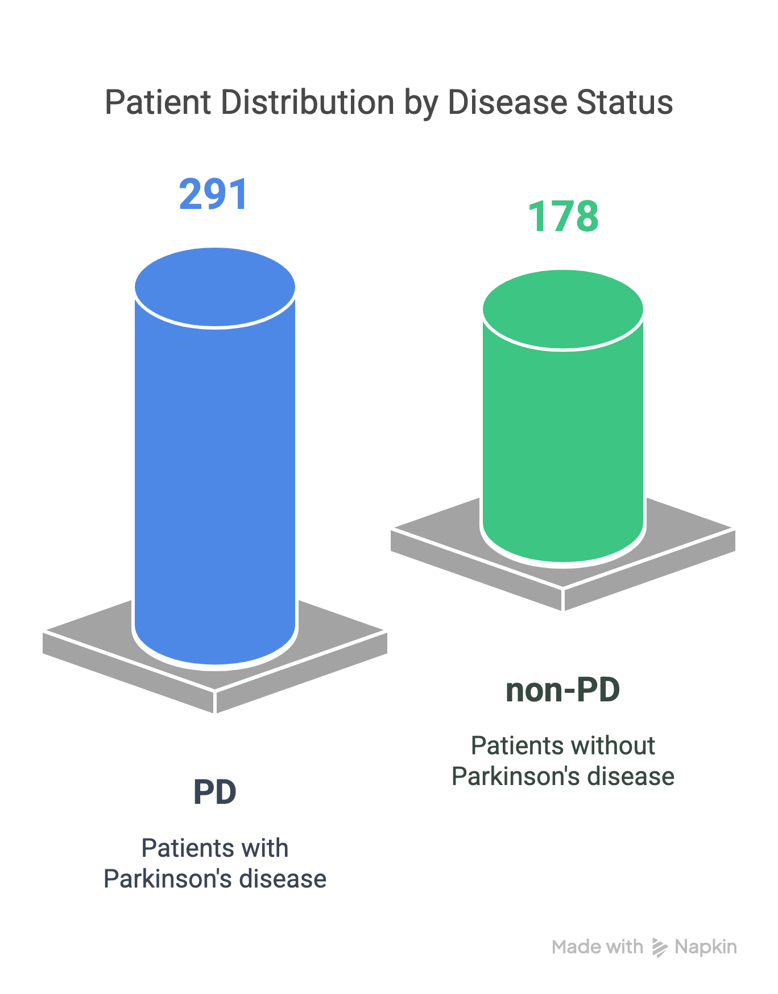
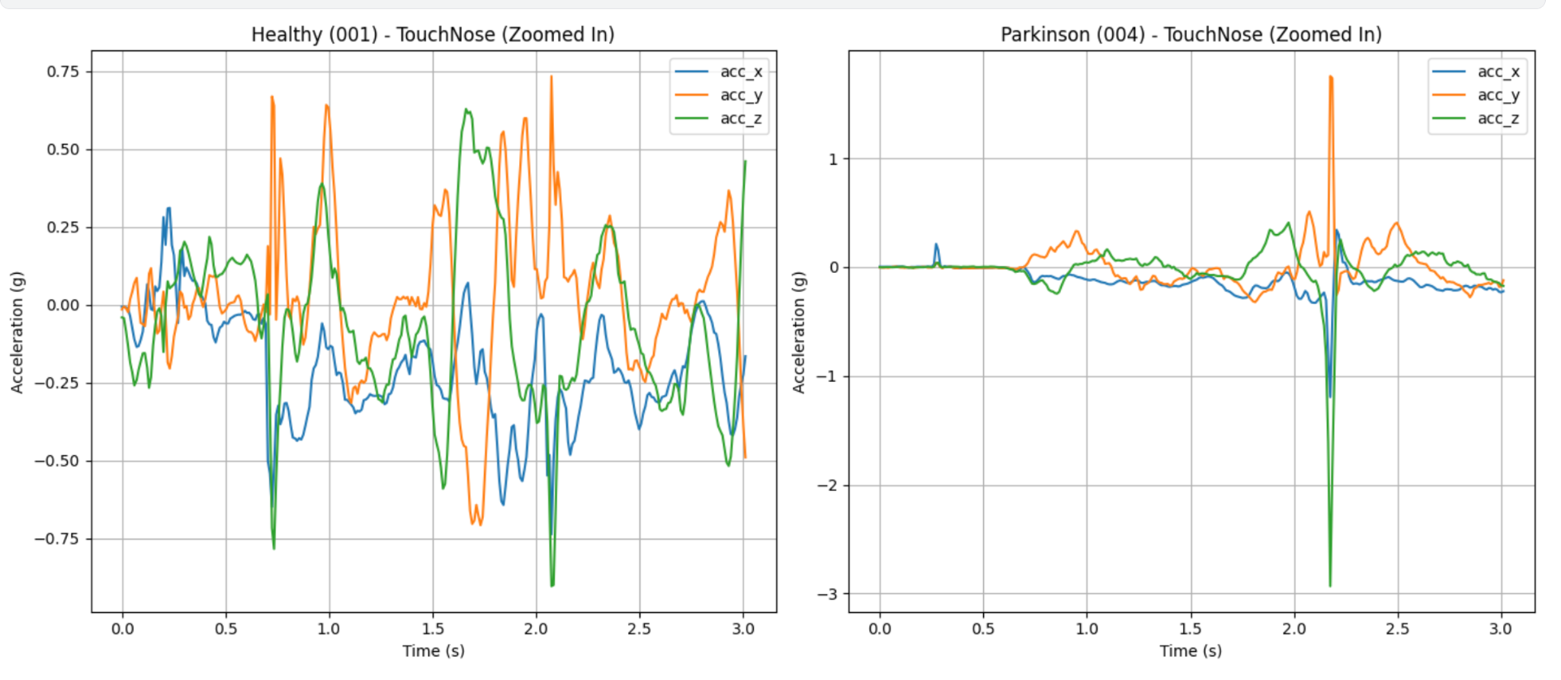
Compared Motion Between Healthy (limit to first 2 seconds)
DataSet used: PADS Parkinson's Disease Smartwatch Dataset (PhysioNet)[1]
Notes:
We have a value inside Demgraphic data that contains - "diagnosis": "Parkinson disease" - This tells you whether this subject has PD or not.
The dataset includes 469 subjects split into three groups: Parkinson’s Disease, healthy individuals, and differential diagnoses. diagnoses (DD), and healthy controls (HC). 62% vs 38%
The motion data actually contains motion sensor time-series data (accelerometer/gyro)
The plot on the right compares the motion sensor data for first 2 second for the task of touching nose.
As we can already see that : Healthy signal should show smooth oscillation, on the left side of the plot
Parkinson signal might have spikes, jerky motion, or more irregularity on the right side of plot

Slide 8
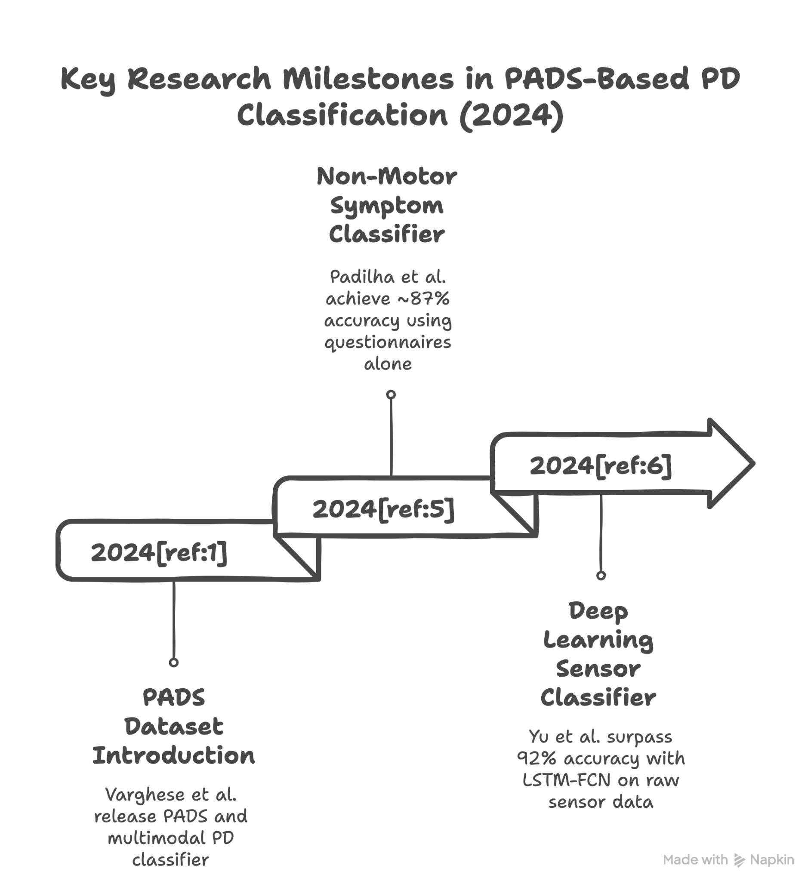
Reference: [1],[5],[6]
Notes:
There were some similar work
Varghese et al. (2024) introduced the PADS dataset and built a multimodal PD classifier using both sensor signals and non-motor questionnaires.
Padilha et al. (2024) used only non-motor symptom responses and achieved ~87% balanced accuracy for PD detection.
Yu et al. (2024) applied deep learning (LSTM-FCN with attention) on raw sensor data and achieved >92% accuracy (PD vs healthy).

Slide 9
Methodology

Slide 10
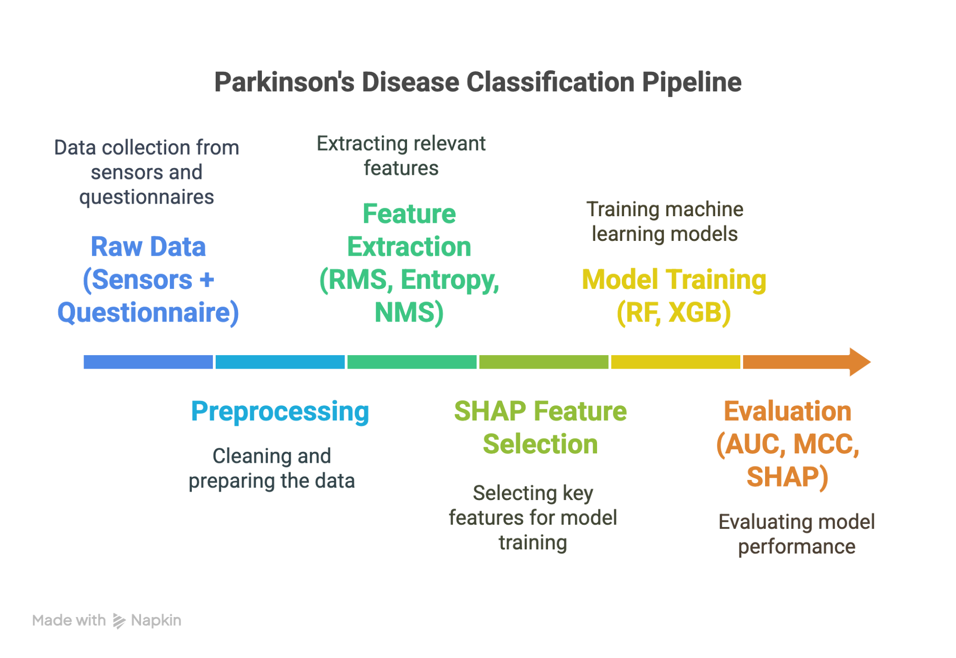
Notes:
“This project was framed as a binary classification task to distinguish Parkinson’s patients from non-Parkinsonian participants.
We began by aligning and cleaning the dataset, which included raw wrist sensor data from movement tasks and structured questionnaire responses. After removing missing or incomplete trials, we synchronized time-series signals and normalized them.
We engineered features such as RMS (motion strength), entropy (signal irregularity), and dominant frequency (oscillatory signature of tremor). These were extracted for each task, per sensor axis.
Then, we merged these sensor-derived features with binary questionnaire responses covering non-motor symptoms like drooling, smell loss, and constipation — giving us a rich, multimodal input per patient.
Feature selection was performed using SHAP, giving us the top 30 most predictive features.
We trained Random Forest and XGBoost, applying GridSearchCV for hyperparameter tuning, and evaluated performance using AUC, MCC, confusion matrix, SHAP explanations, and Brier score to ensure robustness and interpretability.”

Slide 11
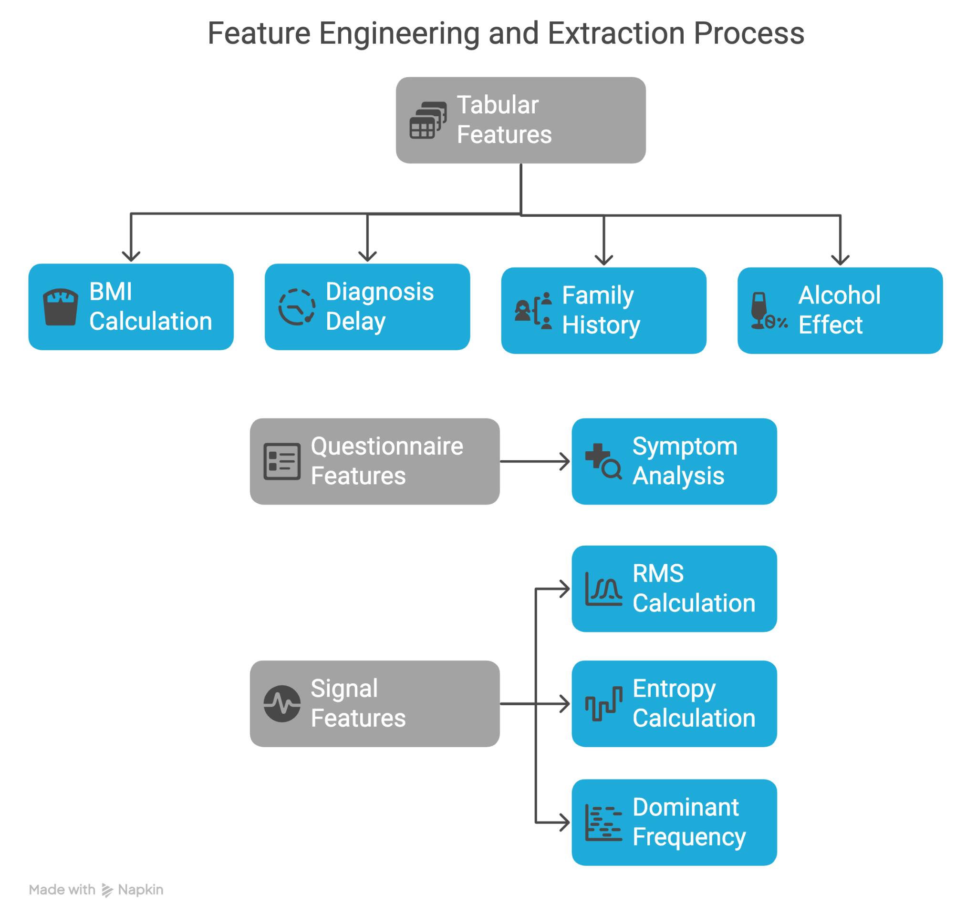
Reference: [2],[3],[4],[5]
Notes:
3. Feature Engineering
Tabular Features
Age, weight, height ➔ BMI - that can be related to gait stability, muscle strength and fall risk and also according to research by julian et al. the Underweight individuals had a 28% higher risk of PD compared to those with normal BMI.
Diagnosis delay: age - age at diagnosis- can correlate the severity as someone diagnosed with PD 1 year ago may move very differently than with someone 10 years ago and the age_at_diagnosis doesnt provide much information alone
Family history (binary) - can help improve model prediction by integrating genetic risk, this value cant be learnt from movements and normal symptoms alone- according to the research done by american academy of neurology- First-degree relatives of PD patients are more than twice as likely to develop PD.
Alcohol effect (categorical)- Alcohol's impact on tremor can help differentiate between types of movement disorders.
“From the motion data, we computed statistical and frequency-based features. These include:
RMS: captures signal strength (how intense the motion is)
Entropy: reflects irregularity — lower in Parkinsonian tremor
Dominant Frequency: to detect rhythmic tremor around 4–6 Hz
These features were extracted separately for each axis (x/y/z) of accelerometer and gyroscope signals, across the three chosen tasks: TouchNose, Relaxed, and PointFinger.
In parallel, we used the 30 binary answers from the non-motor symptom questionnaire, which included questions on smell, sleep, digestion, etc.
These were then concatenated into a single feature vector for each subject, combining motor and non-motor information.”

Slide 12
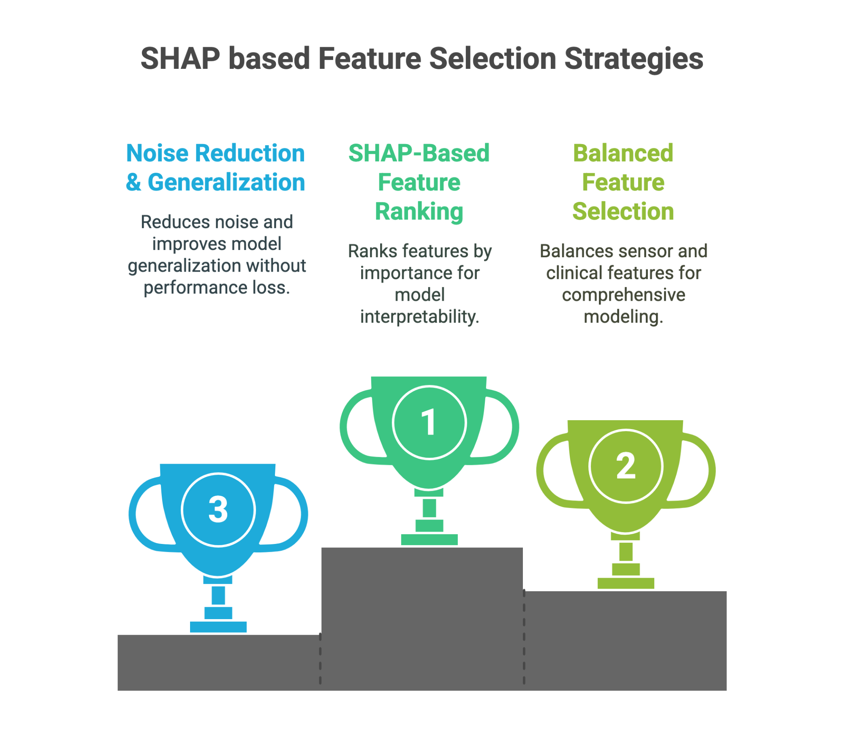
Notes:
“We used SHAP — Shapley Additive Explanations — as our feature importance tool.
SHAP is based on game theory and calculates a fair contribution for each feature to a prediction, just like how you’d split rewards among teammates based on contribution.
Unlike traditional feature importance, SHAP provides both:
Global importance: Which features are most important across all subjects
Local explanation: Why did the model predict ‘PD’ for this individual?
SHAP also helped us identify which clinical features were consistently predictive — for example, taste_smell_loss, sleep_talk_move, and TouchNose_gyro_entropy were all highly ranked and interpretable by medical domain knowledge.”

Slide 13
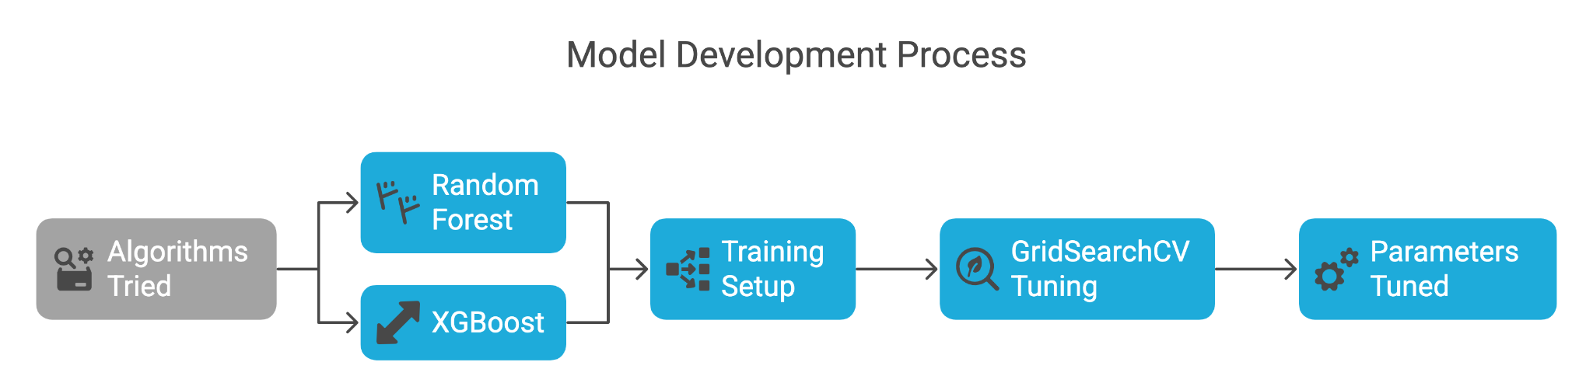
Notes:
“For model development, I experimented with two main algorithms: Random Forest and XGBoost.
Random Forest was chosen because it’s a strong baseline — it’s interpretable, handles both categorical and continuous features, and performs well on relatively small datasets without much tuning.
XGBoost was included because it’s powerful for structured data and also integrates smoothly with SHAP for explainability. It served both as a classifier and a tool for ranking feature importance.
For training, I used a stratified train-test split to preserve the original class balance between Parkinson’s and non-Parkinson’s subjects.
I didn’t feed all features into the model — instead, I selected the top 30 features based on SHAP values, which gave us a good trade-off between performance and interpretability.
On top of that, I ran GridSearchCV to fine-tune the Random Forest. I tested parameters like n_estimators, max_depth, min_samples_leaf, and also used class_weight='balanced' to handle the mild class imbalance.

Slide 14
Results

Slide 15
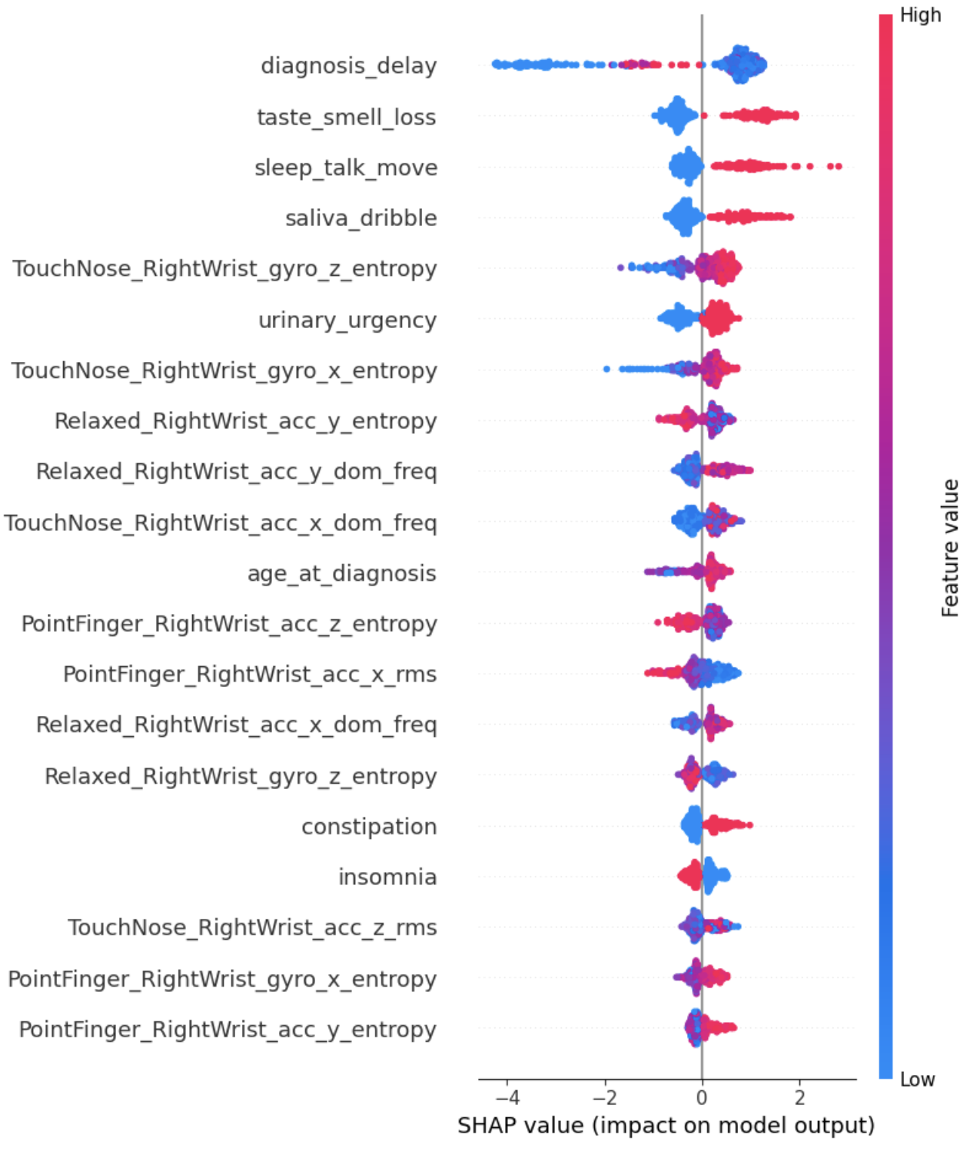
Top SHAP Features + Clinical Relevance
Rank | Feature Name | Type | Interpretation
1 | diagnosis_delay | Demographic | Longer delay increases likelihood of Parkinson’s diagnosis
2 | taste_smell_loss | Questionnaire | Classic early non-motor symptom
3 | sleep_talk_move | Questionnaire | REM sleep behavior disorder – linked to PD progression
4 | saliva_dribble | Questionnaire | Reflects motor control decline
5 | TouchNose_RightWrist_gyro_z_entropy | Signal | Irregular movement patterns in dynamic task
6 | urinary_urgency | Questionnaire | Autonomic dysfunction common in PD
7 | Relaxed_RightWrist_acc_y_dom_freq | Signal | Reflects dominant tremor frequency
Notes:
“We used SHAP for global and local interpretability. It tells us not just what the model predicted, but why.”
“Local SHAP values show symptom combinations — like taste loss + abnormal motion — influencing positive Parkinson prediction.”
“Our SHAP analysis ranks features by how much they push predictions towards Parkinson’s or not.” “We observe both signal-based and questionnaire-derived features in top rankings, showing the benefit of multimodal fusion.” “The entropy and dominant frequency measures capture the irregularity and presence of tremor, while symptoms like taste loss, REM disorder, and salivation are clinically linked to PD.”
Overall, SHAP confirmed the value of combining multiple modalities and validated my choice of task-specific signal features.
Top predictors:
🧠 diagnosis_delay — longer disease duration strongly indicates PD
👃 taste_smell_loss and 🛌 sleep_talk_move — known early non-motor symptoms
🦾 TouchNose_RightWrist_gyro_z_entropy — irregular movement during dynamic tasks signals motor impairment
Takeaway:
Dynamic motion tasks (e.g., TouchNose) combined with clinical symptoms form the most effective feature set — supporting a multimodal, clinically grounded approach to Parkinson’s classification.

Slide 16
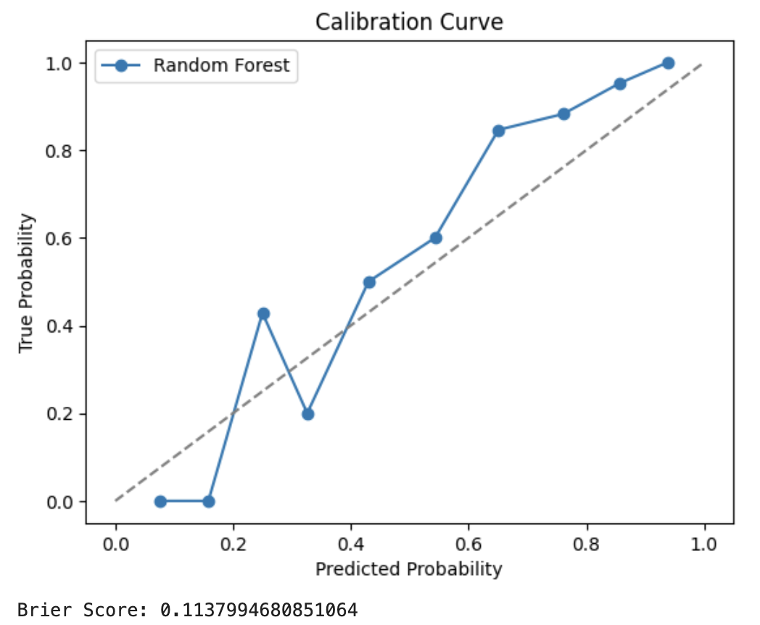
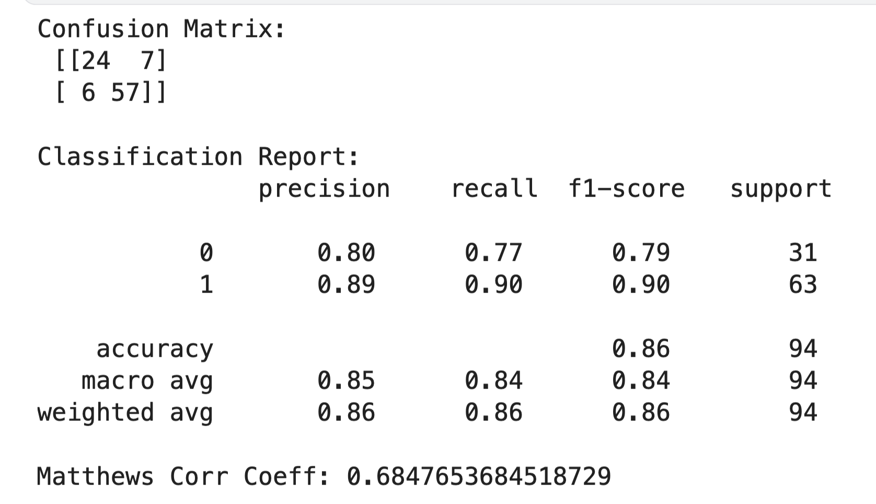
Model Performance
Model | AUC | Accuracy | MCC | Brier Score | # Features
Random Forest | 0.9150 | 86% | 0.68 | 0.11 | 30 (SHAP)
XGBoost | 0.8884 | 84% | 0.65 | 0.13 | 30 (SHAP)
RF (all features) | 0.9042 | 87% | 0.69 | 0.12 | 97
Notes:
"We tested both Random Forest and XGBoost using the top 30 SHAP-ranked features. Random Forest gave the best overall performance, with an AUC of 0.9150 and a well-calibrated probability output reflected in a low Brier Score of 0.11.
Interestingly, even though using all 97 features gave slightly higher raw scores, the SHAP-pruned version retained nearly the same performance with better interpretability.
Pruning actually improved Random Forest performance over the full version (which was 0.9042).
You now have a compact, interpretable, high-performing model.
Random Forest wins on this dataset — use it as your final model.
Keep SHAP results from XGBoost to explain feature importance — it’s perfectly valid.
Accuracy is misleading in imbalanced datasets. MCC penalizes all error types symmetrically and is more informative.
AUC measures discrimination, MCC handles imbalance, and Brier reflects calibration — essential when probabilities may inform triage decisions.
We see slightly higher false positives — acceptable in screening. Better to err on the side of caution in clinical triage.
AUC = 0.9150 → Strong class separation capability
Accuracy = 86% → High overall prediction performance
MCC = 0.685 → Balanced binary metric accounting for all 4 confusion matrix values
F1-score (PD) = 0.90 → Harmonizes precision and recall
Brier Score = 0.113 → Indicates well-calibrated probability outputs

Slide 17
Comparative Analysis

Slide 18
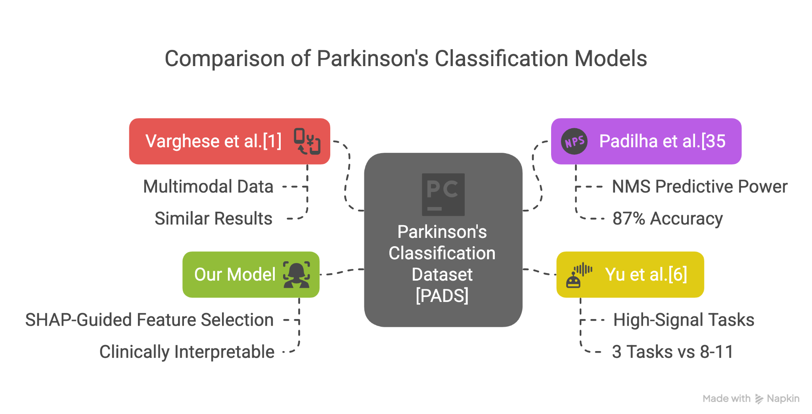
Study | Tasks | Data Type | AUC | Notes
Varghese[1] | 11 | Sensors + NMS | ~91% | No SHAP, no task pruning
Padilha[5] | 0 | NMS only | ~87% | Symptoms-only approach
Yu (DL)[6] | 8 | Raw IMU only | ~92% | Black-box deep model
Ours | 3 | Sensors + NMS | ~91.5% | Few tasks, interpretable
Notes:
Agreement with Prior Work:
Like Varghese et al., our model uses multimodal (sensor + symptom) data → achieved similar results (~91% AUC)
Like Padilha et al., we confirmed Non-Motor-Symptoms alone (e.g., taste_smell_loss, nocturia) are highly predictive of PD (they got 87% accuracy with NMS only)
Our inclusion of SHAP = more clinically interpretable than their information gain methods
Like Yu et al., we focused on high-signal tasks — but achieved similar results using just 3 tasks vs 8–11, thanks to focused SHAP-guided feature selection
Compared to other studies using the PADS dataset:
Varghese used all 11 tasks and achieved strong accuracy, but with no interpretability tools.
Padilha used only the non-motor symptoms questionnaire, achieving 87% accuracy.
Yu et al. used LSTM-based deep learning but required full-length time-series and lacked interpretability.
Our method used only 3 tasks and NMS data — yet matched or exceeded their performance, and added interpretability via SHAP.

Slide 19
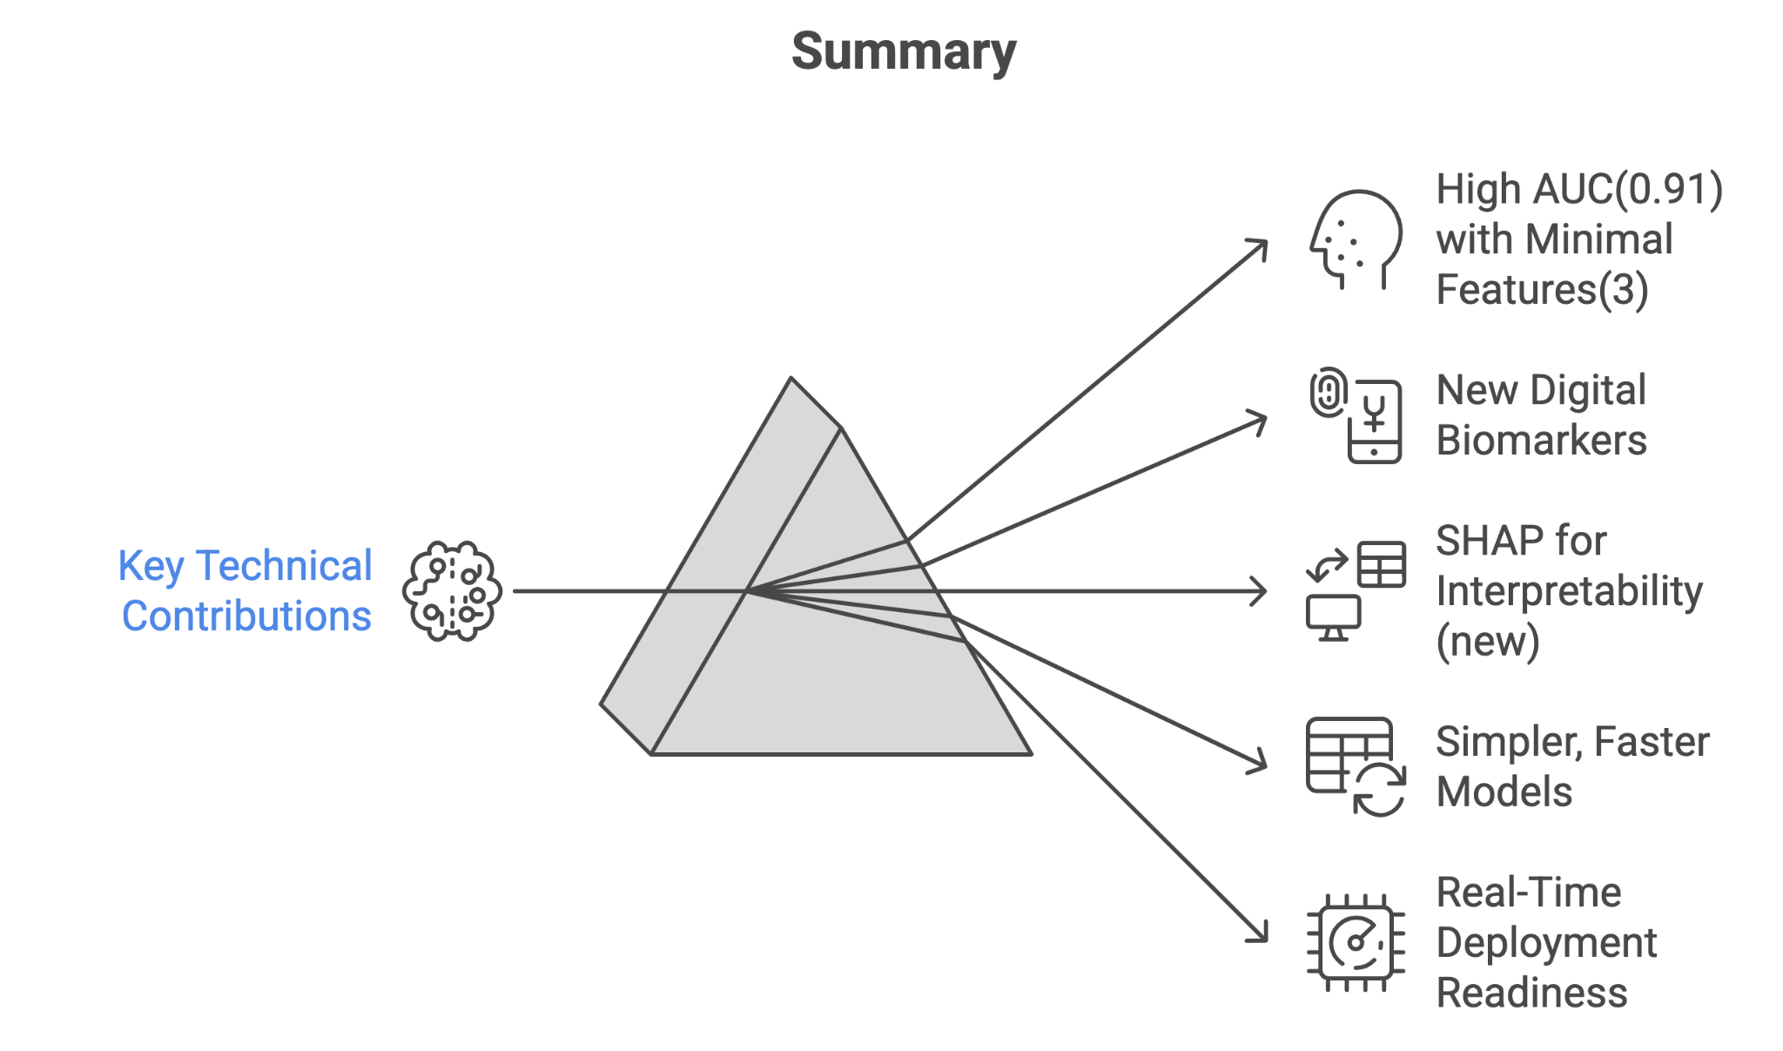
Notes:
Summary of Key Technical Contributions
Achieved AUC = 0.9150 using only 3 motor tasks + selected NMS features
Introduced entropy and dominant frequency as new digital biomarkers for PD along with BMI, family history, diagnostic delay, effect of alcohol
Used SHAP to ensure interpretability at patient level (first in PADS work) and to find which features contributes most
Matched or exceeded existing work using much simpler, faster models
Model is compact, explainable, and ready for real-time screening or mobile deployment

Slide 20
Discussion

Slide 21
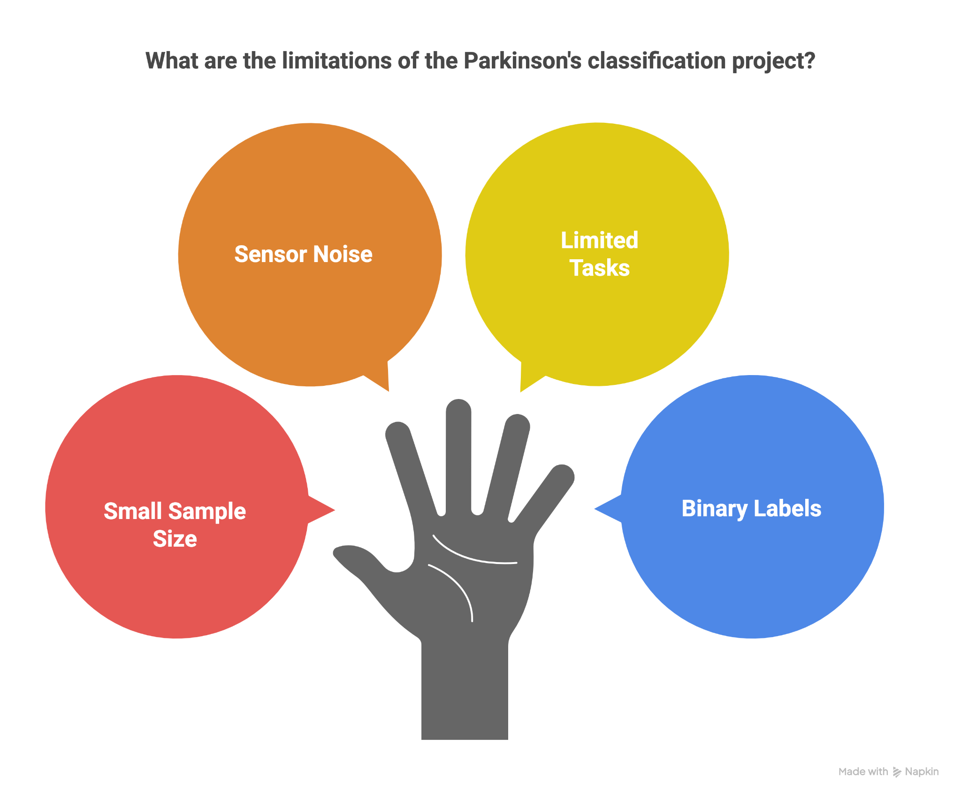
Notes:
“While the results are promising, it's important to recognize some key limitations of this study.
First, although 469 patients is relatively good for clinical datasets, it’s still considered modest for machine learning, especially for deep models or fine-grained feature learning.
Second, we’re dealing with real-world wrist sensor data, which introduces variability — in how the device is worn, subject compliance, or background movement noise. This could affect signal quality.
Third, we only analyzed three of the eleven available tasks. This limits our understanding of other movement patterns — for example, postural control or bilateral coordination might be captured in tasks like CrossArms or HoldWeight.
And finally, the dataset only provides binary labels: Parkinson’s vs non-Parkinson’s. It doesn’t include diagnosis stage, symptom severity, or treatment data”

Slide 22
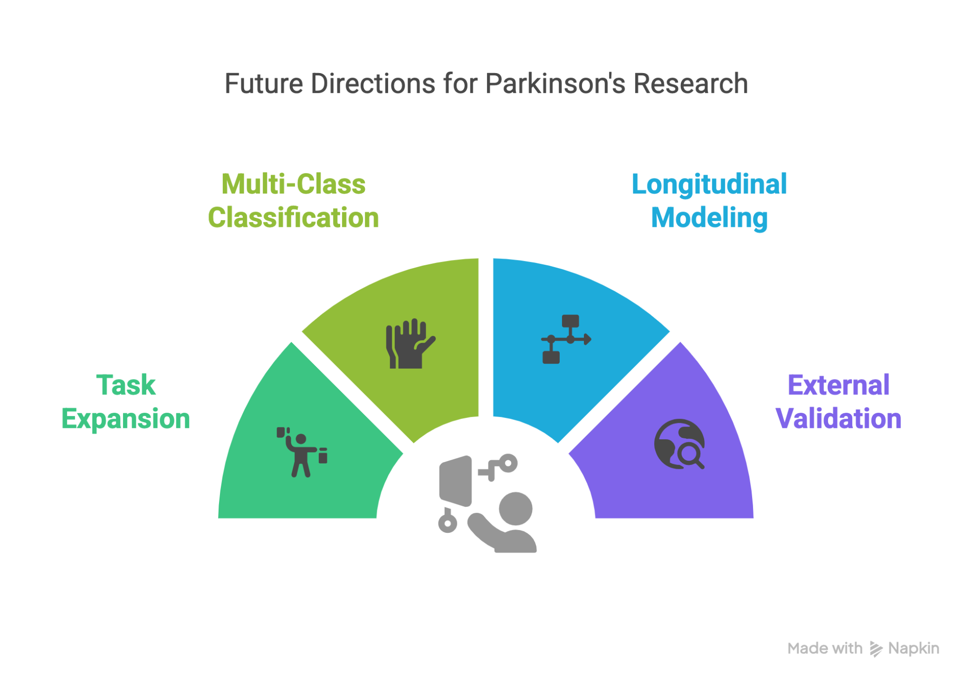
Notes:
“There are several ways this work could be extended in the future.
First, we currently only use 3 tasks — TouchNose, Relaxed, and PointFinger — but the dataset includes tasks like HoldWeight and CrossArms that could offer additional insights into rigidity and postural stability.
Second, rather than binary classification, we could explore a multi-class model to distinguish Parkinson’s from essential tremor, atypical Parkinsonism, and healthy subjects. This would make the model more clinically valuable.
Third, we only used data from the right wrist in this prototype. By including both wrists, we could capture asymmetry — a hallmark of early Parkinson’s disease.
Fourth, the dataset includes repeated visits for some patients, so we could build a longitudinal model to track symptom progression or treatment effects over time.
Finally, to confirm our model’s robustness, we plan to test it on an external dataset — either from a different cohort or sensor setup — to validate generalization beyond PADS.”

Slide 23
Conclusion

Slide 24
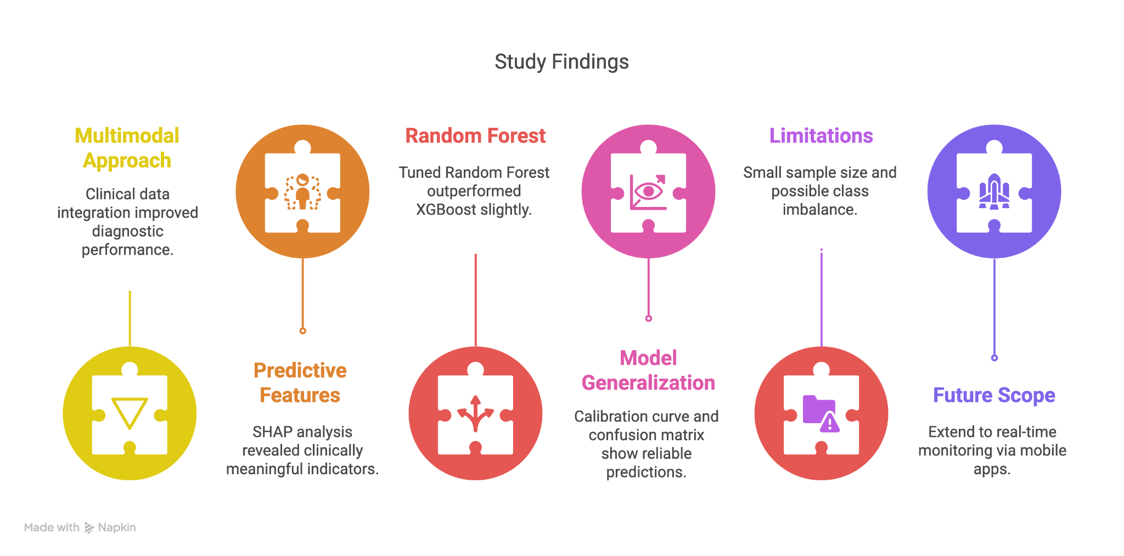
Notes:
"In this project, we showed how a multimodal machine learning pipeline using both clinical questionnaire data and wearable motion signals can effectively classify Parkinson’s Disease."
"Our model achieved strong performance, with a final AUC of over 0.91, particularly when combining diverse feature types. This demonstrates the power of integrating medical and sensor-based data."
"We used SHAP to explain our predictions, and it’s encouraging that the most important features the model used—like taste/smell loss or sleep-talking—are well-documented early indicators of Parkinson’s."
"Interestingly, Random Forest with tuning slightly outperformed XGBoost, especially in metrics like Brier score and MCC. It also gave a more calibrated probability distribution."
"The confusion matrix shows our model is good at avoiding false negatives, which is crucial in clinical screening. We don’t want to miss early PD cases."
"That said, the dataset is relatively small and focused. More diverse tasks and real-world conditions would be ideal for future robustness."
"In future work, I’m excited about translating this pipeline to mobile settings—like real-time monitoring via smartwatch apps—and adding longitudinal analysis for disease progression tracking."

Slide 25
Thank You
Q&A

Slide 26
REFERENCES
https://physionet.org/content/parkinsons-disease-smartwatch/
https://www.nature.com/articles/s41531-023-00625-7
https://sol.sbc.org.br/index.php/erigo/article/download/32241/32041
https://www.mdpi.com/2079-9292/13/23/4638
https://movementdisorders.onlinelibrary.wiley.com/doi/10.1002/mds.27922
https://pmc.ncbi.nlm.nih.gov/articles/PMC3966522
https://www.neurology.org/doi/10.1212/WNL.47.1.155
https://pubmed.ncbi.nlm.nih.gov/20721919/
Images and diagram were generated using: napkin.ai

Slide 27
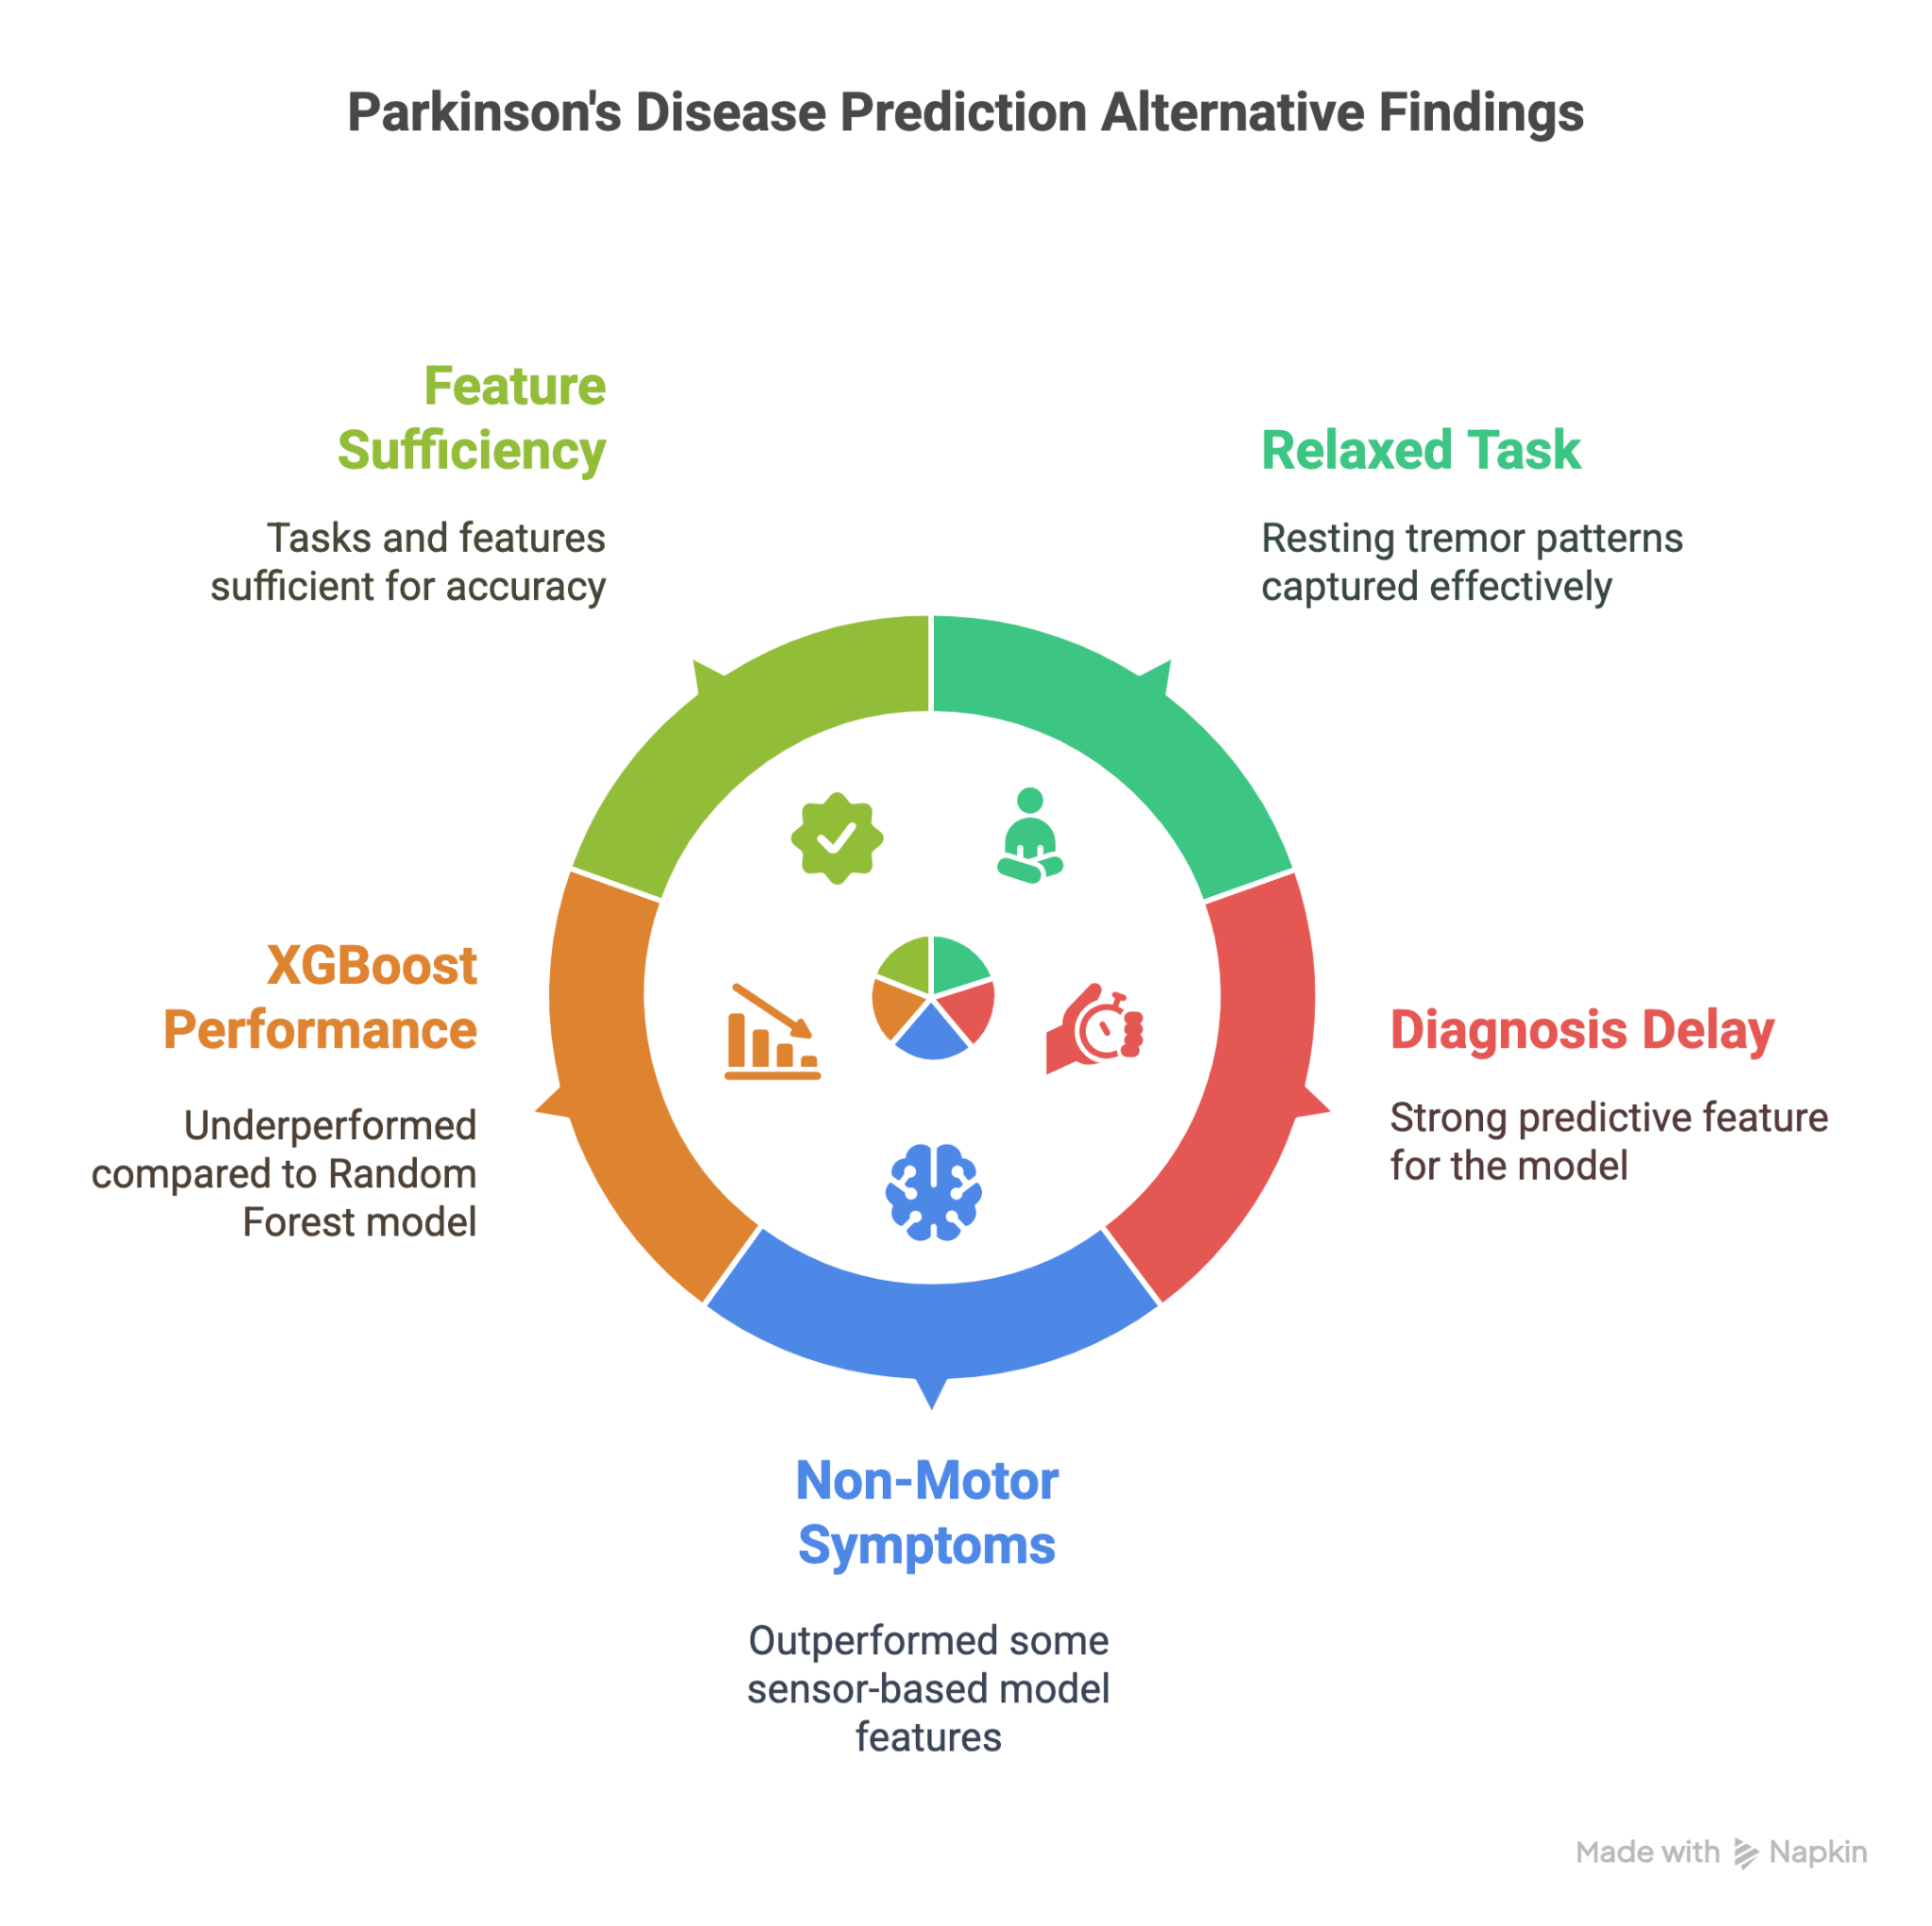

Slide 28
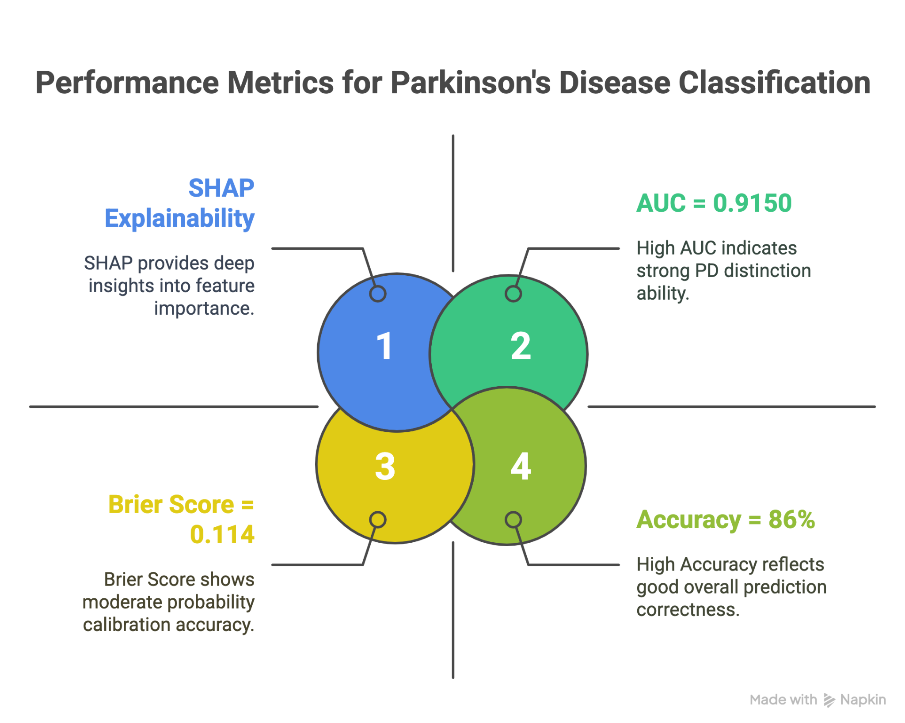

Slide 29
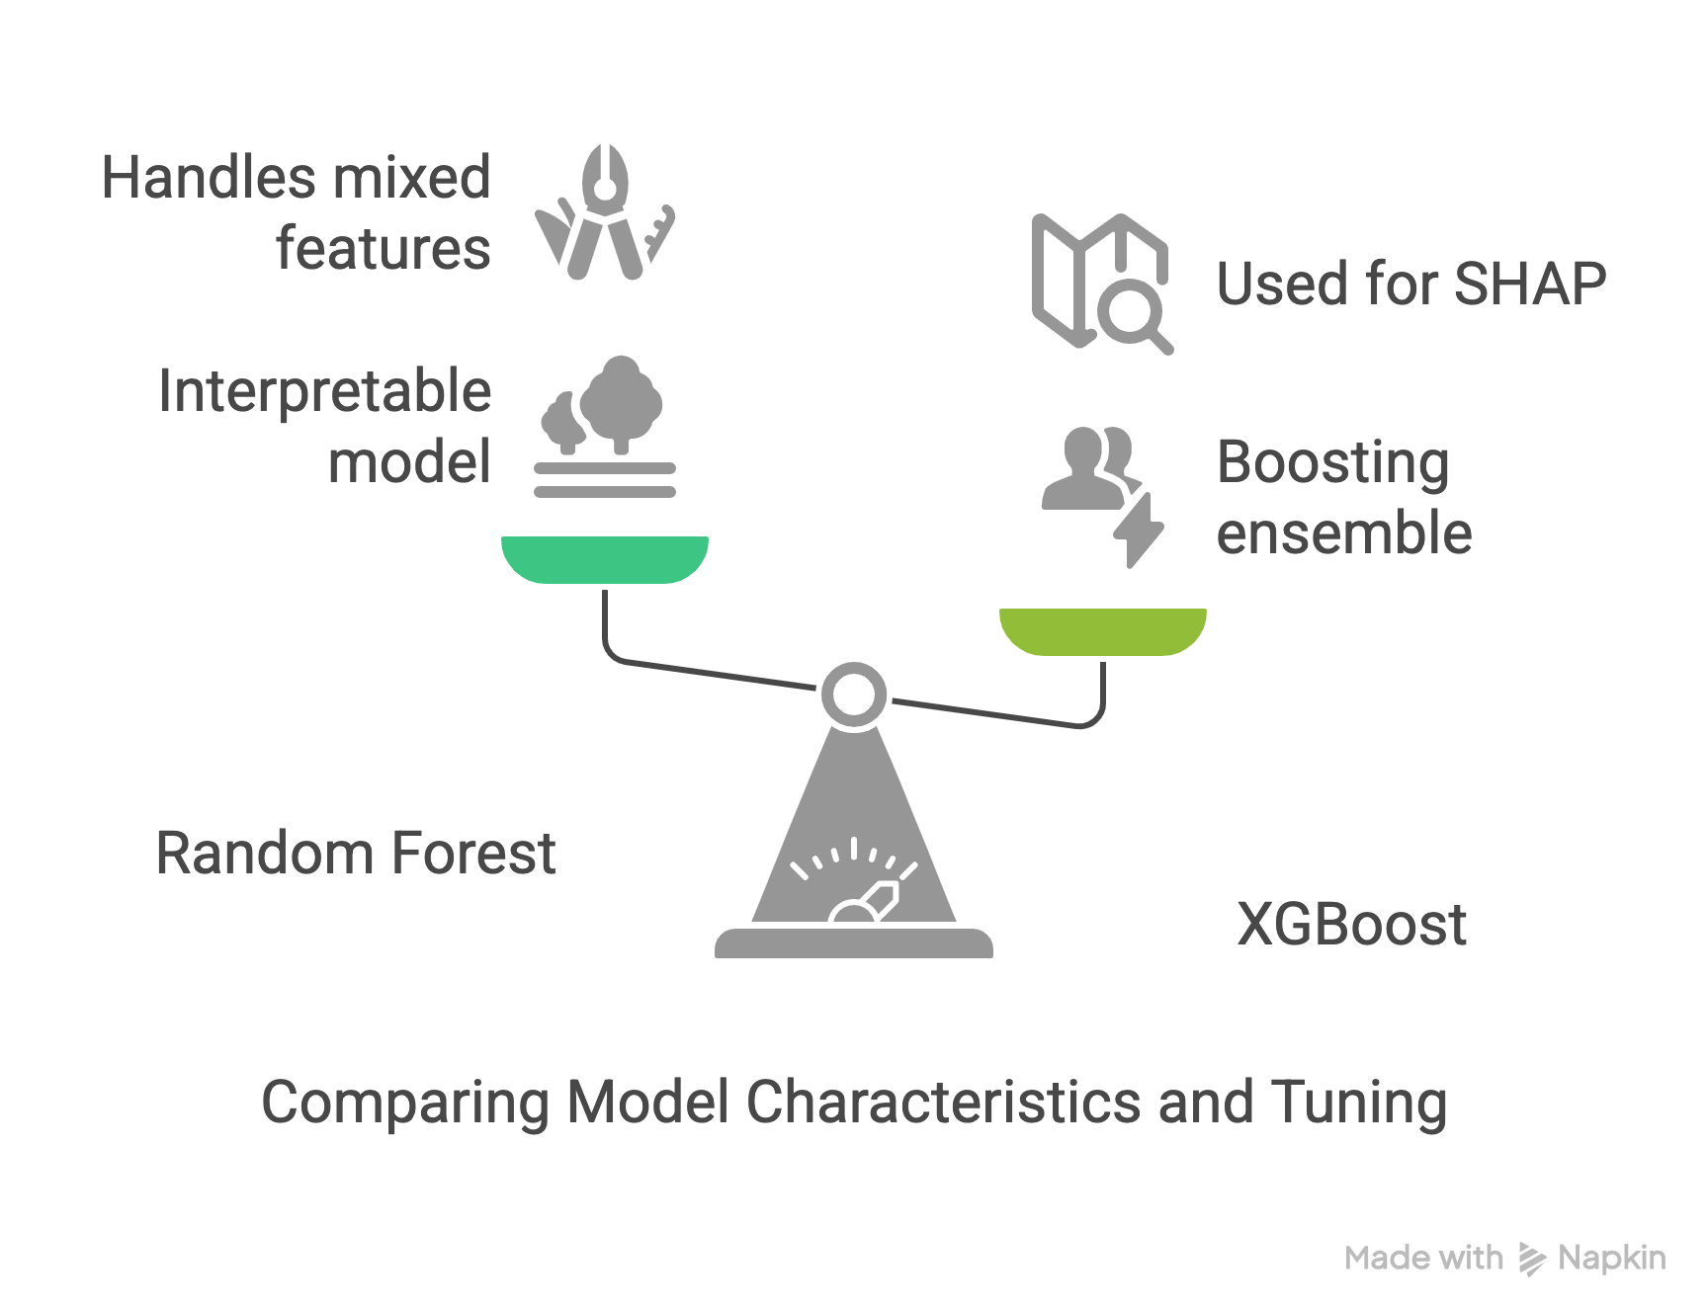

Slide 30
Top 10 Ranked Features + Clinical Relevance
Rank | Feature Name | Type | Interpretation
1 | diagnosis_delay | Demographic | Longer delay increases likelihood of Parkinson’s diagnosis
2 | taste_smell_loss | Questionnaire | Classic early non-motor symptom
3 | sleep_talk_move | Questionnaire | REM sleep behavior disorder – linked to PD progression
4 | saliva_dribble | Questionnaire | Reflects motor control decline
5 | TouchNose_RightWrist_gyro_z_entropy | Signal | Irregular movement patterns in dynamic task
6 | urinary_urgency | Questionnaire | Autonomic dysfunction common in PD
7 | Relaxed_RightWrist_acc_y_dom_freq | Signal | Reflects dominant tremor frequency
8 | TouchNose_RightWrist_gyro_x_entropy | Signal | Chaotic tremor signature
9 | Relaxed_RightWrist_acc_y_entropy | Signal | Indicates noise/inconsistency in limb control
10 | age_at_diagnosis | Demographic | Older age at diagnosis is slightly predictive due to disease progression rate
Notes:
“Our SHAP analysis ranks features by how much they push predictions towards Parkinson’s or not.”
“We observe both signal-based and questionnaire-derived features in top rankings, showing the benefit of multimodal fusion.”
“The entropy and dominant frequency measures capture the irregularity and presence of tremor, while symptoms like taste loss, REM disorder, and salivation are clinically linked to PD.”

